Slide 1
Budweiser Exploratory Data Analysis
Presented by FoamFingerMakers

Slide 2
Agenda
We will use the data to understand the following questions:
Where are breweries located in the United States?
Where did we land post data clean up?
What is the median ABV and IBU in each state?
Who has the most alcoholic and most bitter beer?
What does the ABV distribution look like in the United States?
Is there a relationship between ABV and IBU?
Can we create a model to identify a beer as IPAs?
What markets are good test areas for a new beer?

Slide 3
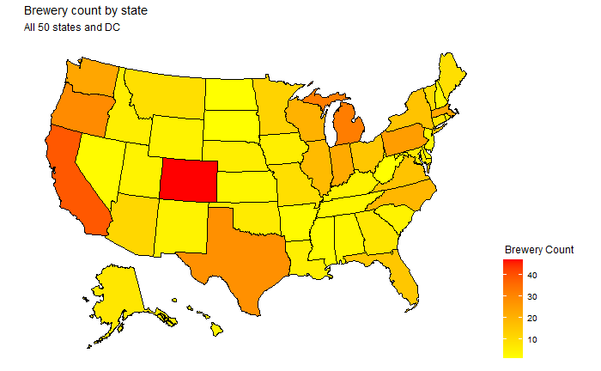
Brewery distribution in the United States

Slide 4
Data Clean Up
Removed 1,007 observations from the data due to missing values in:
ABV
IBU
Style
Remaining data set, 1,403 observations, is adequate for analysis.

Slide 5
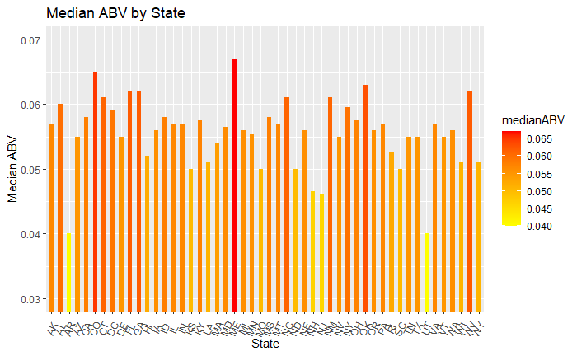
Median ABV for each State?
Highest ABV Beer?
Where: Louisville, KY
Brewer: Against the Grain Brewery
Name: London Balling
ABV: 12.5%

Slide 6
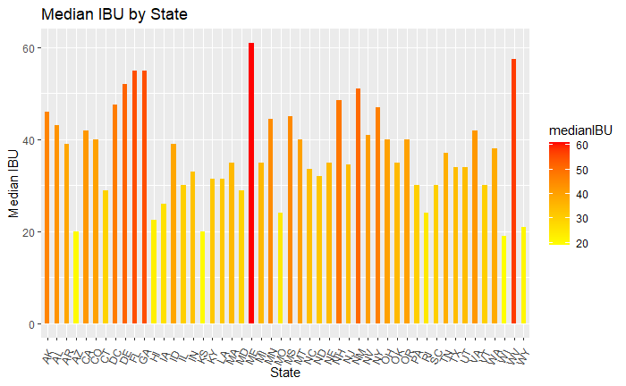
Median IBU for each State?
Most Bitter Beer?
Where: Astoria, OR
Brewer: Astoria Brewing Company
Name: Bitter Bitch Imperial IPA
IBU: 138

Slide 7
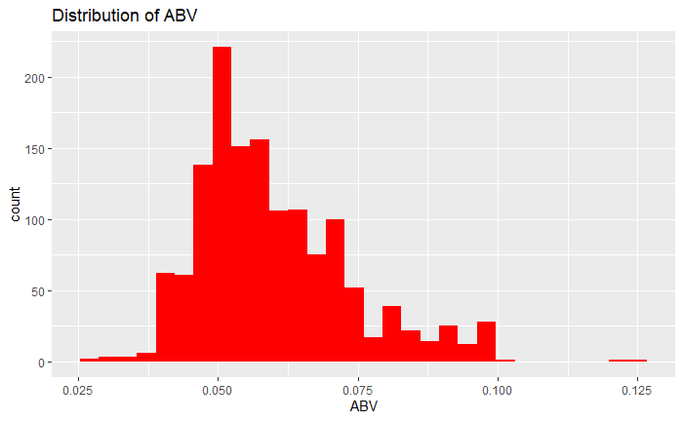
ABV: Summary Statistics and Distribution
Summary Statistics:
Mean: .060
Median: .057
Standard Deviation: .014
Max: .125
Min: .027
Comments:
ABV distribution has a slight right skew and a low spread

Slide 8
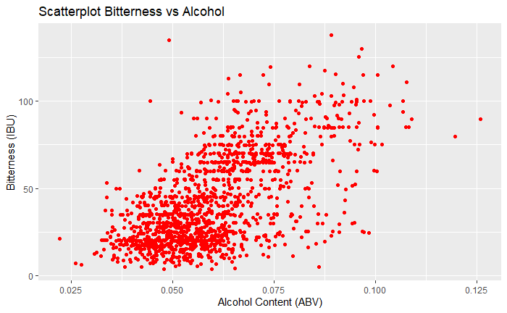
Relationship between ABV and IBU?
Comments:
Appears to be a positive linear relationship between Bitterness and Alcohol Content. As the ABV increases, the IBU increases.

Slide 9
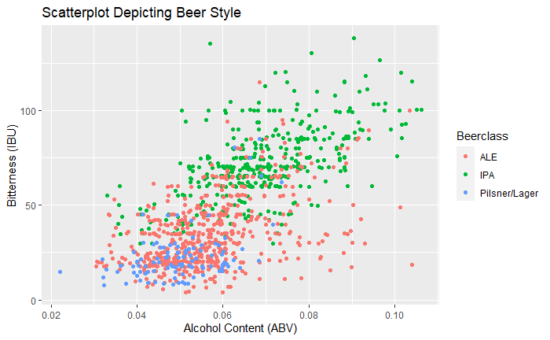
Can we identify an IPA?
Identifier stats:
Accuracy: 74%
Sensitivity: 76%
Specificity: 88%

Slide 10
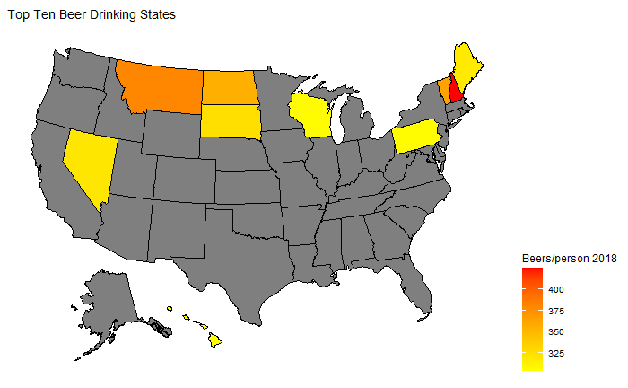
Where do we release a new IPA?
Top 10 Markets:
New Hampshire
Montana
Vermont
North Dakota
South Dakota
Nevada
Maine
Pennsylvania
Wisconsin
Hawaii

Slide 11
Summary
High competition states are Colorodo, California, Oregon, and Michigan
Average of all beers seed ABV at 5.5% and IBU > 30
Highest ABV was London Balling out of KY
Highest Bitterness was Bitter Bitch Imperial IPA out of OR
What does the ABV distribution look like in the United States?
Proved Positive correlation between ABV and IBU
KNN can accurately classify beers by type for new releases
New England region is prime market for new IPA beer with low competition from other breweries

